Slide 1
Presentation title
Mirjam Nilsson​

Slide 2
Stations of The Holy Family

Slide 3
Opening Prayer
O God our heavenly Father, with grateful hearts we come before you, the Author of all family life.
Through your Son Jesus, you have shared with us your own divine life, so great is your love for all of us.

Slide 4
Opening Prayer
Guide us as we meditate on these great events in the life of the Holy Family of Jesus, Mary, and Joseph.
We ask their help for our families who experience today many of the difficulties, challenges, and hardships that this Blessed Family experienced so long ago.

Slide 5
Opening Prayer
May this Holy Family be for us a source of inspiration and courage.
May they give us the strength to obey the Gospel message of mutual love and respect for all of our brothers and sisters.

Slide 6
Opening Prayer
May we, who together make up the Body of Christ on earth, remember always that truly we are all members of the Family of God.
To Jesus, Mary, and Joseph, we entrust today our many needs and intentions.
Amen.

Slide 7
Holy Family Station 1

Slide 8
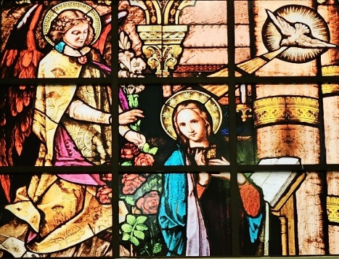
The Annunciation of the Blessed Virgin Mary

Slide 9
Leader: O Most Holy Family, Jesus, Mary, and Joseph; intercede for us who seek your help. All: For in you, we place all our faith and all our trust.

Slide 10
Meditation: Luke 1:35-38 ‘The Holy Spirit will come upon you’ the angel answered ‘and the power of the Most High will cover you with its shadow. And so, the child will be holy and will be called Son of God.

Slide 11
Meditation: Luke 1:35-38 Know this too: your kinswoman Elizabeth has, in her old age, herself conceived a son, and she whom people called barren is now in her sixth month, for nothing is impossible to God'

Slide 12
Meditation: Luke 1:35-38 ‘I am the handmaid of the Lord,’ said Mary ‘let what you have said be done to me.

Slide 13
Reflection: We gather as a family before the Father Almighty, inspired by the sacred event of the Annunciation to the Blessed Virgin Mary.

Slide 14
Reflection: As we reflect upon the blessed moment in history, we seek His presence and guidance in our lives. Just like Mary did, with hearts open to receive His divine will.

Slide 15
Prayer: All Holy Mary, teach us to say “yes” to God’s call, even in the midst of uncertainty and fear.

Slide 16
Prayer: All Help us to trust in His providence and to embrace His plan, even when it may seem beyond our understanding.

Slide 17
Prayer: All Strengthen our faith, dear Mother, that we may wholeheartedly offer our families to the service of God and our fellow human beings.

Slide 18
Prayer: All Glory Be to the Father...

Slide 19
Holy Family Station 2

Slide 20
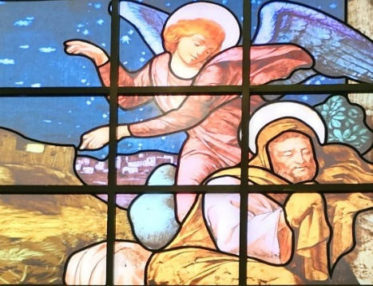
The Angel came to Joseph in a dream

Slide 21
Leader: O Most Holy Family, Jesus, Mary, and Joseph; intercede for us who seek your help. All: For in you, we place all our faith and all our trust.

Slide 22
Meditation: Matt 1 20-23 “...the angel of the Lord appeared to him in a dream and said, ‘Joseph son of David, do not be afraid to take Mary home as your wife, because she has conceived what is in her by the Holy Spirit.

Slide 23
Meditation: Matt 1 20-23 She will give birth to a son and you must name him Jesus, because he is the one who is to save his people from their sins. ‘Now all this took place to fulfil the words spoken by the Lord through the prophet:

Slide 24
Meditation: Matt 1 20-23 ‘The virgin will conceive and give birth to a son and they will call him Emmanuel, a name which means ‘God-is-with-us’. When Joseph woke up he did what the angel of the Lord had told him to do: he took his wife to his home.

Slide 25
Reflection: We marvel at Joseph’s obedience and faith, deep trust of Providence as he received the angel’s message.

Slide 26
Reflection: In the face of confusion and uncertainty, Joseph trusted God’s guidance and willingly accepted the extraordinary task of becoming the earthly father of His beloved Son.

Slide 27
Prayer: All In our own families, dear Joseph, we ask for your intercession. Protect and strengthen our relationships, deepen our love for one another, and grant us the grace to imitate the Holy Family’s virtues.

Slide 28
Prayer: All May we nurture an atmosphere of faith, harmony, and unconditional love, just as you did with Mary and Jesus.

Slide 29
Prayer: All Glory Be to the Father...

Slide 30
Holy Family Station 3

Slide 31
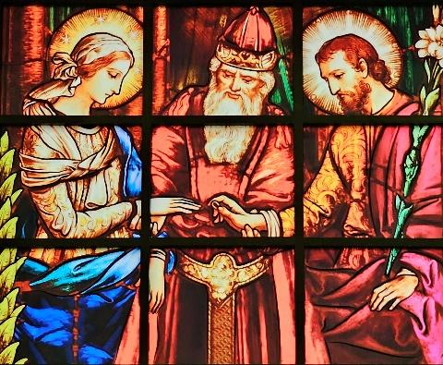
Mary & Joseph are married

Slide 32
Leader: O Most Holy Family, Jesus, Mary, and Joseph; intercede for us who seek your help. All: For in you, we place all our faith and all our trust.

Slide 33
Meditation: Matthew 1:18-21 When His mother Mary was betrothed to Joseph, but before they lived together, she was found with Child through the Holy Spirit.

Slide 34
Meditation: Matthew 1:18-21 Joseph her husband, since he was a righteous man, yet unwilling to expose her to shame, decided to divorce her quietly. Such was his intention when, behold, the angel of the Lord appeared to him in a dream and said, "Joseph, son of David, do not be afraid to take Mary your wife into your home.

Slide 35
Meditation: Matthew 1:18-21 For it is through the Holy Spirit that this Child has been conceived in her. She will bear a son and you are to name him Jesus, because he will save his people from their sins."

Slide 36
Reflection: Many marriages suffer because frequently the couples do not understand fully the sacredness of this special bond of love.

Slide 37
Reflection: There are so many temptations to be unfaithful or to abandon the covenant rather than to work to correct what is wrong.

Slide 38
Reflection: What is lacking is a strong faith and trust in the Lord who has promised His help all the days of their married lives.

Slide 39
Prayer: All By the sacrament of matrimony, a man and a woman enter into a sacred covenant relationship based on mutual love, trust, and self-donation.

Slide 40
Prayer: All We pray for all married couples. We pray especially for those experiencing difficulties; that they will be faithful always to their vows and will seek the help of the Holy Family to resolve their problems.

Slide 41
Prayer: All Glory Be to the Father...

Slide 42
Holy Family Station 4

Slide 43
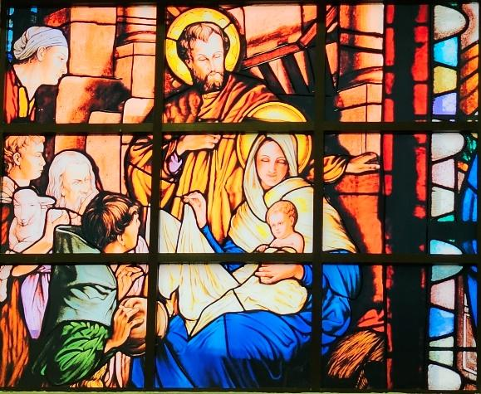
Jesus is born to Mary, His Mother and to Joseph, His Foster Father (The Sanctity of Human Life Eminently Manifested in the Birth of a Child)

Slide 44
Leader: O Most Holy Family, Jesus, Mary, and Joseph; intercede for us who seek your help. All: For in you, we place all our faith and all our trust.

Slide 45
Meditation: Luke 2:6-7 While they were there, the time came for her to have her child, and she gave birth to her firstborn son. She wrapped him in swaddling clothes and laid him in a manger, because there was no room for them in the inn.

Slide 46
Reflection: It is so difficult to believe that anyone would deliberately kill a child. And yet, abortion is exactly that. We believe that a new, unrepeatable human life begins to live at the moment of conception.

Slide 47
Reflection: Then why do so many bitterly fight for the right to choose to kill these children? Perhaps because those who choose abortion and all other crimes against human life no longer see the beauty of God's creation.

Slide 48
Prayer: All The true beauty and glory of all of God’s creation can be seen in the face of a newborn child. With every child, God embraces us with His endless love.

Slide 49
Prayer: All We pray that all people will come to respect human life, especially the lives of unborn children. Let us pray ceaselessly for an end to abortion and to all the other crimes against human life: God’s greatest and most beautiful creation.

Slide 50
Prayer: All Glory Be to the Father...

Slide 51
Holy Family Station 5

Slide 52
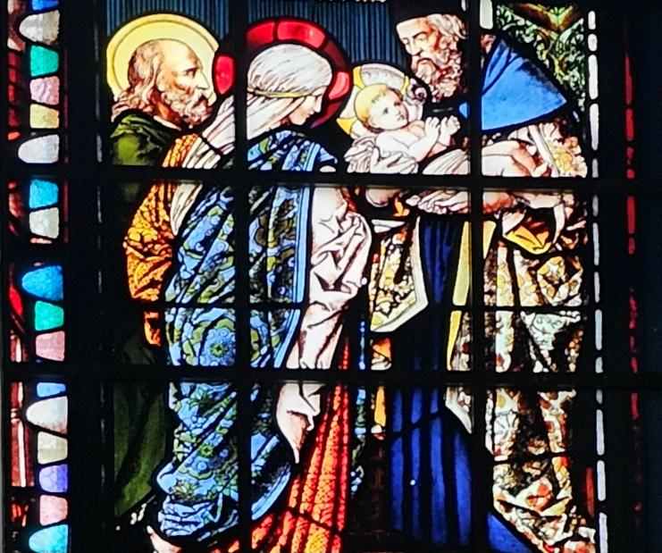
Mary & Joseph present the Child Jesus in the Temple (God is First in the Family: The Need to Worship God as Families)

Slide 53
Leader: O Most Holy Family, Jesus, Mary, and Joseph; intercede for us who seek your help. All: For in you, we place all our faith and all our trust.

Slide 54
Meditation: Luke 2:22-24;39 When the days were completed for their purification according to the law of Moses, they took him up to Jerusalem to present him to the Lord, just as it is written in the law of the Lord.

Slide 55
Meditation: Luke 2:22-24;39 "Every male that opens the womb shall be consecrated to the Lord," and to offer the sacrifice of "a pair of turtledoves or two young pigeons," in accordance with the dictate in the law of the Lord.

Slide 56
Meditation: Luke 2:22-24;39 When they had fulfilled all the prescriptions of the law of the Lord, they returned to Galilee to their town of Nazareth.

Slide 57
Reflection: In order for families to be holy, joyful, and healthy, they must have a profound and sincere relationship with God the Creator of all.

Slide 58
Reflection: When our families join together at Holy Mass, they have the opportunity to speak to the Father of Holiness; to receive the Son of Joy, and to be touched by the Holy Spirit of Healing.

Slide 59
Reflection: And yet many of our children have abandoned their Catholic faith and the worship of Our Father in the Holy Sacrifice of the Mass. Let us never cease to work for their return so that one day, united again as families, we will all worship our God from whom all families receive their life and their strength.

Slide 60
Prayer: All We firmly believe that all blessings come from the Lord. What greater blessing can we receive than the gift of our families? To the Lord we owe our praise and gratitude for all of His gifts and blessings.

Slide 61
Prayer: All We pray that all members of our families, especially those who no longer practice their faith, will join together on the Lord's Day to offer Jesus' Holy Mass: the greatest act of thanksgiving the world has ever known.

Slide 62
Prayer: All Glory Be to the Father...

Slide 63
Holy Family Station 6

Slide 64
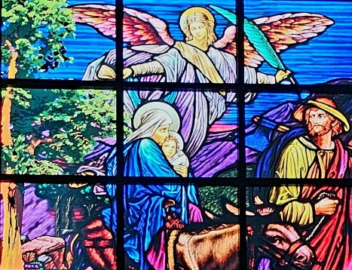
The Holy Family Flees into Egypt (Be compassionate to the many suffering families in the world: The Poor, the Homeless, the Abused)

Slide 65
Leader: O Most Holy Family, Jesus, Mary, and Joseph; intercede for us who seek your help. All: For in you, we place all our faith and all our trust.

Slide 66
Meditation: Matthew 2:13-15 When they had departed, behold, the angel of the Lord appeared to Joseph in a dream and said, "Rise, take the child and his mother, flee to Egypt, and stay there until I tell you. Herod is going to search for the child to destroy him.

Slide 67
Meditation: Matthew 2:13-15 Joseph rose and took the child and his mother by night and departed for Egypt. He stayed there until the death of Herod, that what the Lord had said through the prophet might be fulfilled, "Out of Egypt, I called my son.”

Slide 68
Reflection: There are so many families suffering throughout the world. Many fathers and mothers have no home for themselves or for their children because they've had to flee because of wars, persecution, drought, or famine.

Slide 69
Reflection: Not a few families live in utter poverty even in countries with plenty. Many too suffer because of abuse, addictions, or neglect. We must not close our minds and hearts to their need, for they too are children of Our Father.

Slide 70
Prayer: All Almighty Father, like the Holy Family so long ago, many of your children are suffering even today in a modern world. May we show our love and compassion for them by our deeds.

Slide 71
Prayer: All Let us offer them our prayers, our comfort, and our support so that the Lord may heal them and bring them peace.

Slide 72
Prayer: All Glory Be to the Father...

Slide 73
Holy Family Station 7

Slide 74
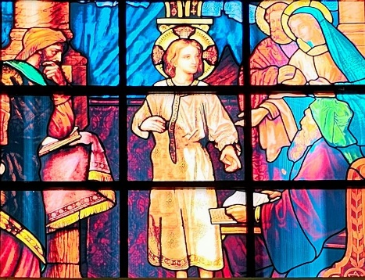
Joseph & Mary Search for Jesus in the Temple (The Pains of Parenthood: The Challenge to be Faithful Parents)

Slide 75
Leader: O Most Holy Family, Jesus, Mary, and Joseph; intercede for us who seek your help. All: For in you, we place all our faith and all our trust.

Slide 76
Meditation: Luke 2:46-48 After three days they found him in the temple, sitting in the midst of the teachers, listening to them and asking them questions, and all who heard him were astounded at his understanding and his answers.

Slide 77
Meditation: Luke 2:46-48 When his parents saw him, they were astonished, and his mother said to him, "Son, why have you done this to us? Your father and I have been looking for you with great anxiety."

Slide 78
Reflection: To be good and caring parents requires much dedication and effort. Parents must learn to die to self so that the tendency toward selfishness will be transformed into a willingness to sacrifice all things for their children.

Slide 79
Reflection: Far too many parents have yet to learn this great lesson of selfless love. The desire to put personal interests first is a temptation that never rests.

Slide 80
Prayer: All We pray that all married couples who accept the responsibility of parenthood will also accept the challenges this vocation demands.

Slide 81
Prayer: All O Holy Family, do not let parents forget their duty to sacrifice self so that their children too may learn to love and to serve.

Slide 82
Prayer: All Glory Be to the Father...

Slide 83
Holy Family Station 8

Slide 84
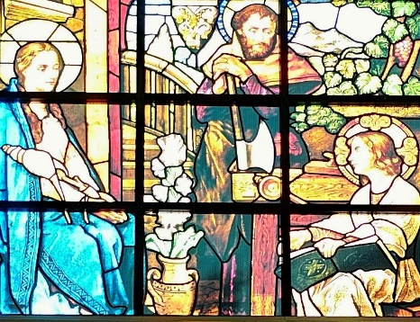
The Holy Family in Nazareth (The Importance of a Holy, Happy, and Stable Family)

Slide 85
Leader: O Most Holy Family, Jesus, Mary, and Joseph; intercede for us who seek your help. All: For in you, we place all our faith and all our trust.

Slide 86
Meditation: Luke 2:39-40 When they had fulfilled all the prescriptions of the law of the Lord, they returned to Galilee, to their own town of Nazareth. The child grew and became strong, filled with wisdom; and the favour of God was upon him.

Slide 87
Reflection: A family can achieve holiness and happiness only in an environment of peace, security, and stability. There is today, however, a common experience that is very different.

Slide 88
Reflection: Broken marriages, physical and mental abuse, uncontrolled anger, and frustration have all made the environment hostile to peace, security, and stability.

Slide 89
Reflection: Let us return to the basic plan of God: Fathers and mothers committed to each other and dedicated to the family, aided by the grace of the sacrament of matrimony.

Slide 90
Prayer: All Let us pray that all families will follow the example of the Holy Family and work to achieve that peace and happiness that only the Lord can give. Lord, be with them in all their efforts. Reward them for their fidelity.

Slide 91
Prayer: All Glory Be to the Father...

Slide 92
Closing Prayer
Almighty Father, prayerfully we have relived these events in the life of the Holy Family.
We have undertaken this journey because our families are in need of the love and the guidance and the strength that only the Holy Family can give.

Slide 93
Closing Prayer
Meditating on these events in the lives of Jesus, Mary, and Joseph, we have come to understand that their joys are our joys, their difficulties are our difficulties, and their sorrows are our sorrows.
With confidence then we place our families in the loving embrace of the Holy Family.

Slide 94
Closing Prayer
Through their intercession, may our families grow in love and in harmony. May this Holy Family be an example to all who seek to do your divine will.
And may we all come to understand more fully that imitating the life of the Holy Family is the only way to achieve the love and respect upon which depends on the sanctity of all families.

Slide 95
Closing Prayer
Heavenly Father, grant us your blessings as we strive to be your faithful and loving children. Help us by the prayers of this Holy Family of Nazareth to be good and holy families seeking to please you in all things for the greater glory of your name and for our eternal salvation. Amen.

Slide 96
Closing Prayer
Glory Be to the Father. . .

